Slide 1
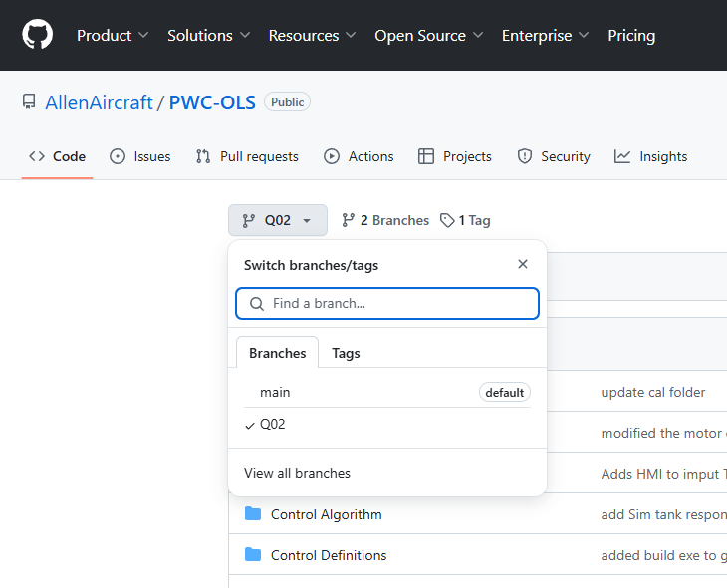
Step 2

Slide 2
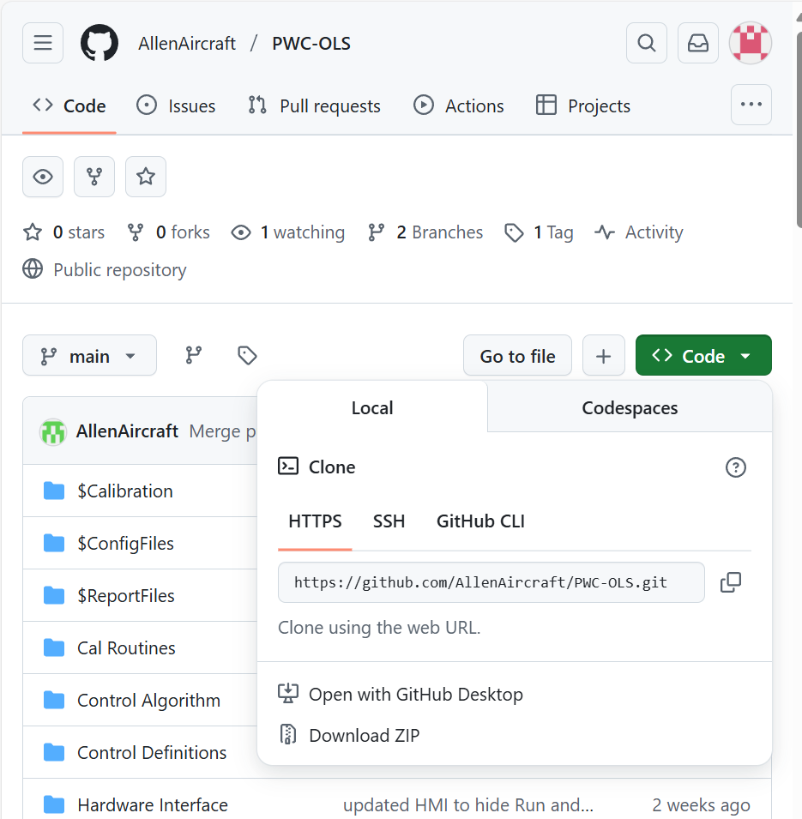
Step 5

Slide 3
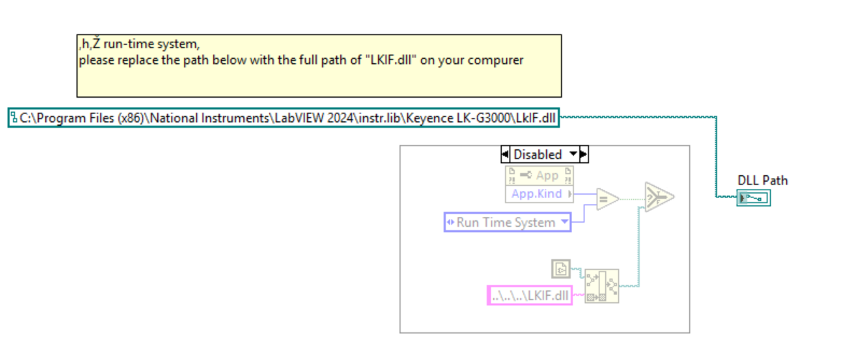
C:\Program Files (x86)\National Instruments\LabVIEW 2024\instr.lib\Keyence LK-G3000\Private\vi\Get DLL Path.vi

Slide 4
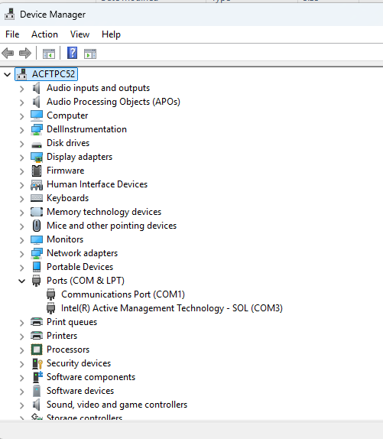
Step 2

Slide 5
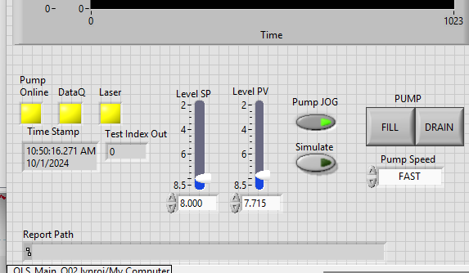
1
2
3
SIM button

Slide 6
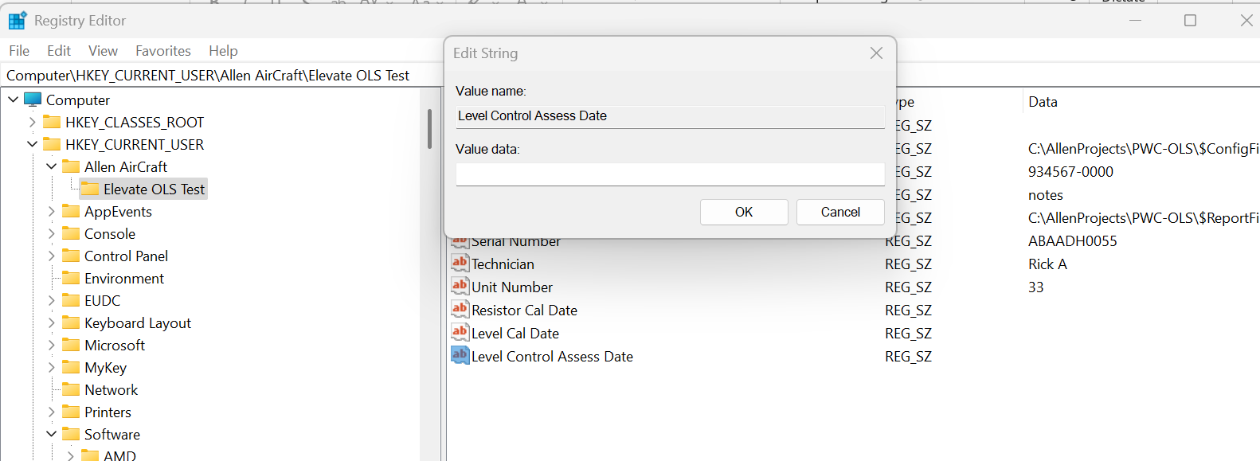
Enter date here
Navigate to this Key
Edit this Value

Slide 7
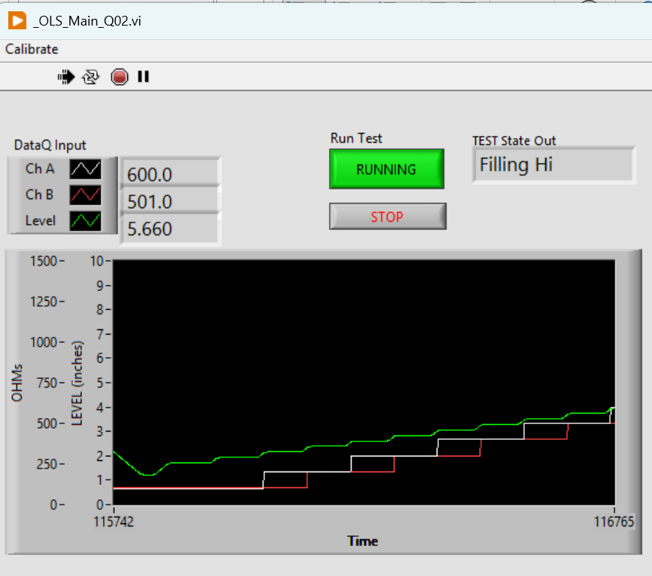
System State and Mode indicator
Click to START or END the automatic Test protocol
STOPS and Exit the application
GREEN Level
WHITE ChA
RED ChB

Slide 8
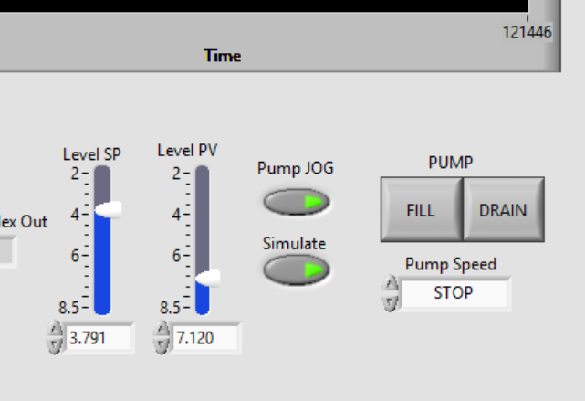
With Pump JOG button:
ON, the FILL and DRAIN buttons and the Pump Speed dropdown control the pump.
OFF then the Level (PV) goes to the SP.
Process Variable (PV) The measured Level.
Set Point (SP) The desired Level in automatic.
NOTE: SP, PV and Level indicate:
Tank is EMPTY when Level ~8.2”
Tank is FULL when Level ~ 2.4”
With Simulate ON, the Level PV and Green Plot should simulate the tank level.

Slide 9
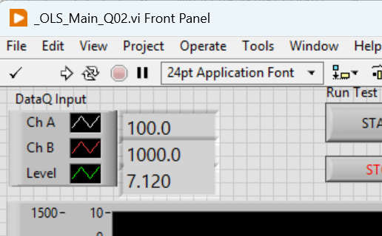
ChA Value.
ChB Value.
Level Value.

Slide 10
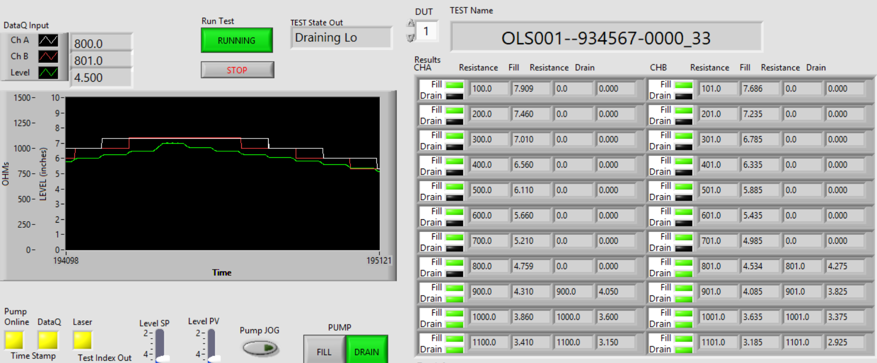
Measured Resistance
(4 places)
Measured Target Test Level
(4 places)
Current Test State
When Running (Green) The test protocol state machine sets the SP in automatic mode to create the stairstep level values.
FILL and DRAIN Status lights,
GREEN = PASS
RED = FAIL
YELLOW = Test Error
BLACK = Not Tested
ChA FILL
ChA DRAIN
ChB FILL
ChB DRAIN

Slide 11
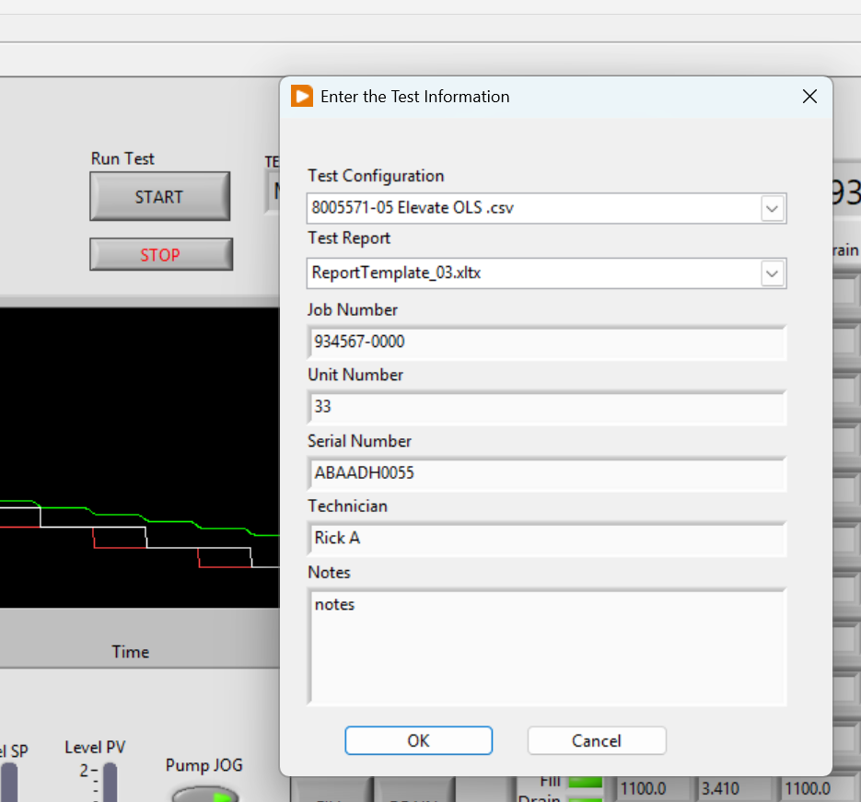
Test Information Dialog
STOP and Exit button.
Test Information Fields (7 Places)

Slide 12
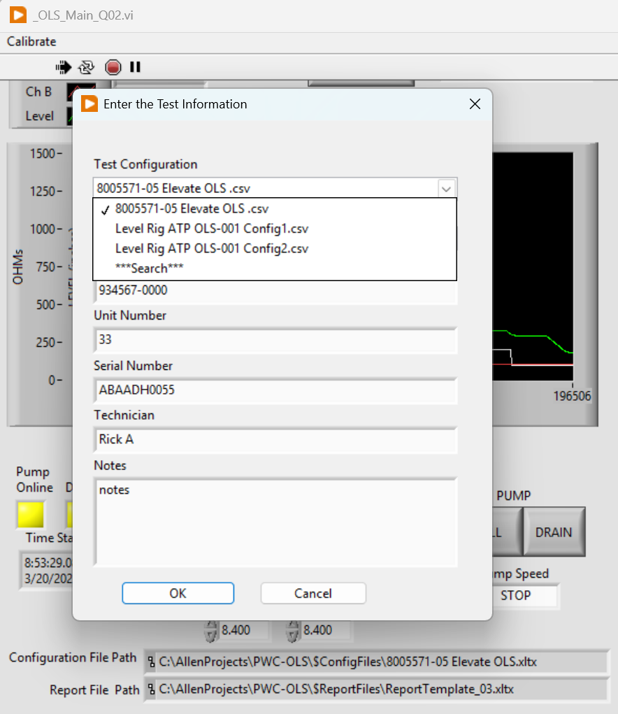
Config File Selection Field
Saved in Register
Currently Selected
Available Selection in current folder
Change Folder
Currently Selected
Full Path & Name

Slide 13
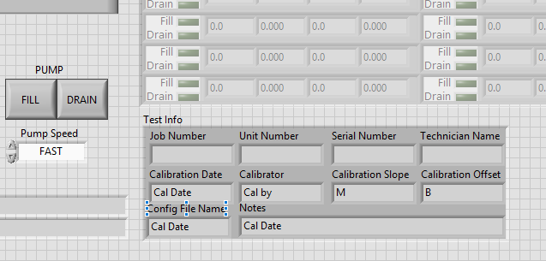
Test Information

Slide 14
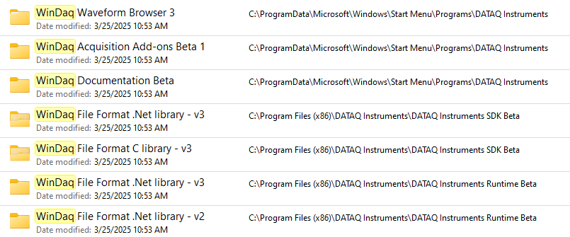
WinDaq Data Acquisition Software
PicoScope oscilloscope software and PicoLog data logging software
Pololu Simple Motor Controller 18v7 (Fully Assembled)

Slide 15
Switching between LibUSB and CDC Modes The native communication mode of the DI-2108-P is LibUSB but it can be switched to the USB CDC (Communication Device Class). CDC mode allows the USB port of DI-2108-P devices to appear like a traditional RS-232 port, which is common across most operating systems and development languages. Please note: LibUSB communication is required for WinDaq Acquisition software and programming with our .NET SDK. Only switch to CDC mode when writing your own programs at the protocol level (for example, Python applications). Use the following sequence to switch your device to/from LibUSB/CDC modes:
Connect the device to your PC via the USB port.
Apply power to the device.
When mode LED stops blinking white and is in Idle mode, push and hold the Control button. This must be completed within five seconds after the device is in Idle mode.
When the mode LED turns red, release the Control button. 5. The Mode LED will flash white then indicate Idle in either LibUSB or CDC mode: • CDC mode: Blinking Yellow • LibUSB mode: Blinking Green

Slide 16
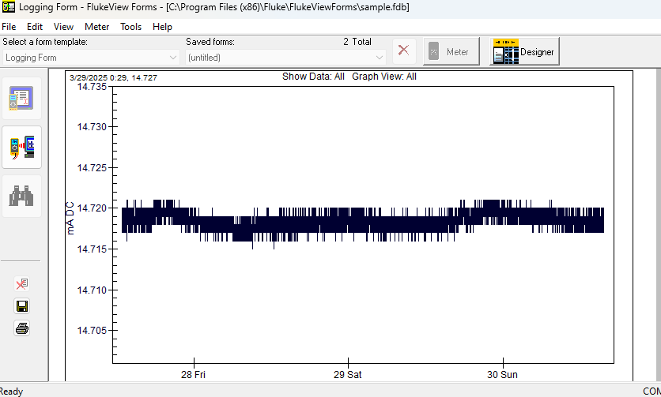
Fluke mA 3/28 to 4/1

Slide 17
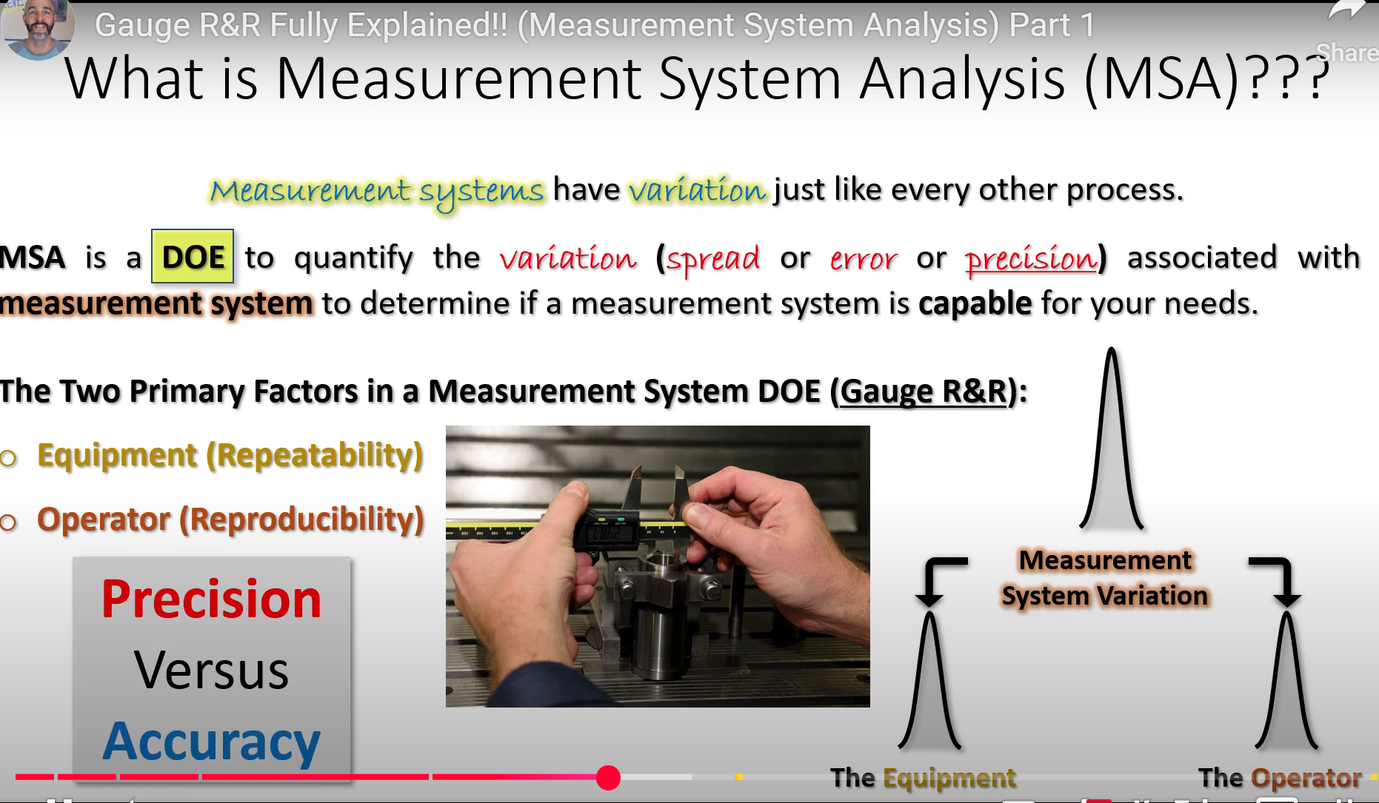
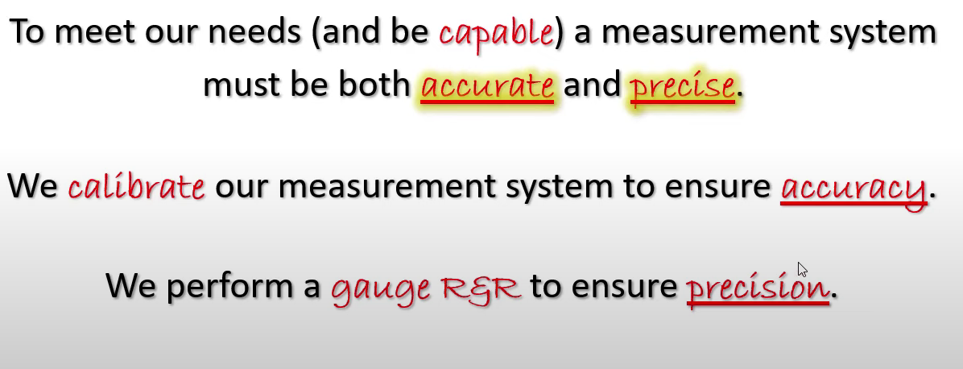
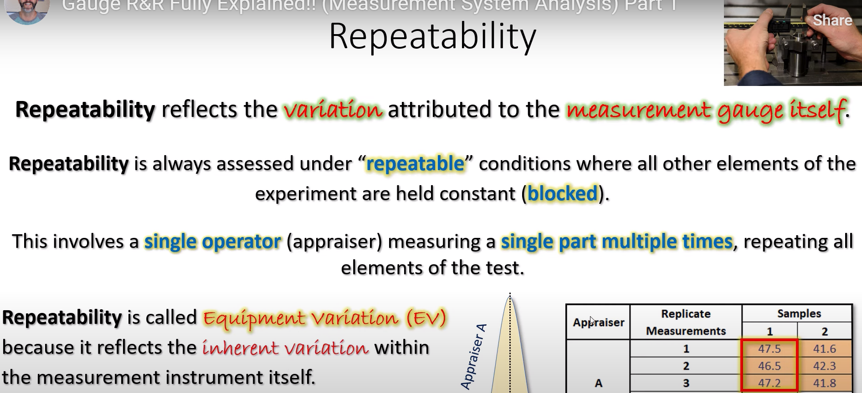
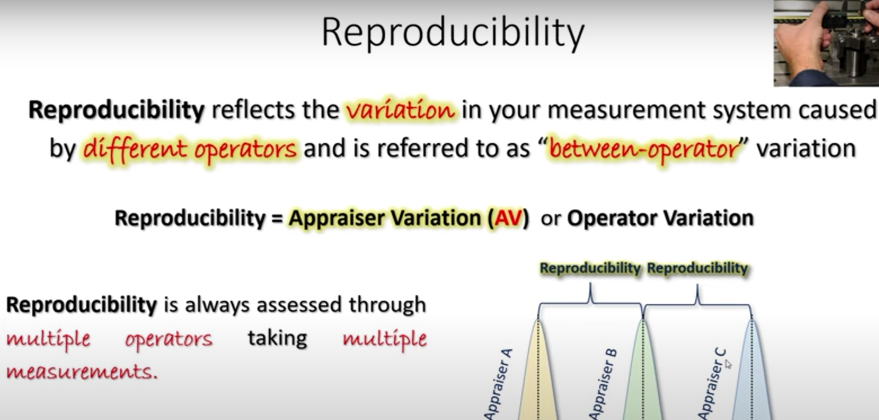

Slide 18
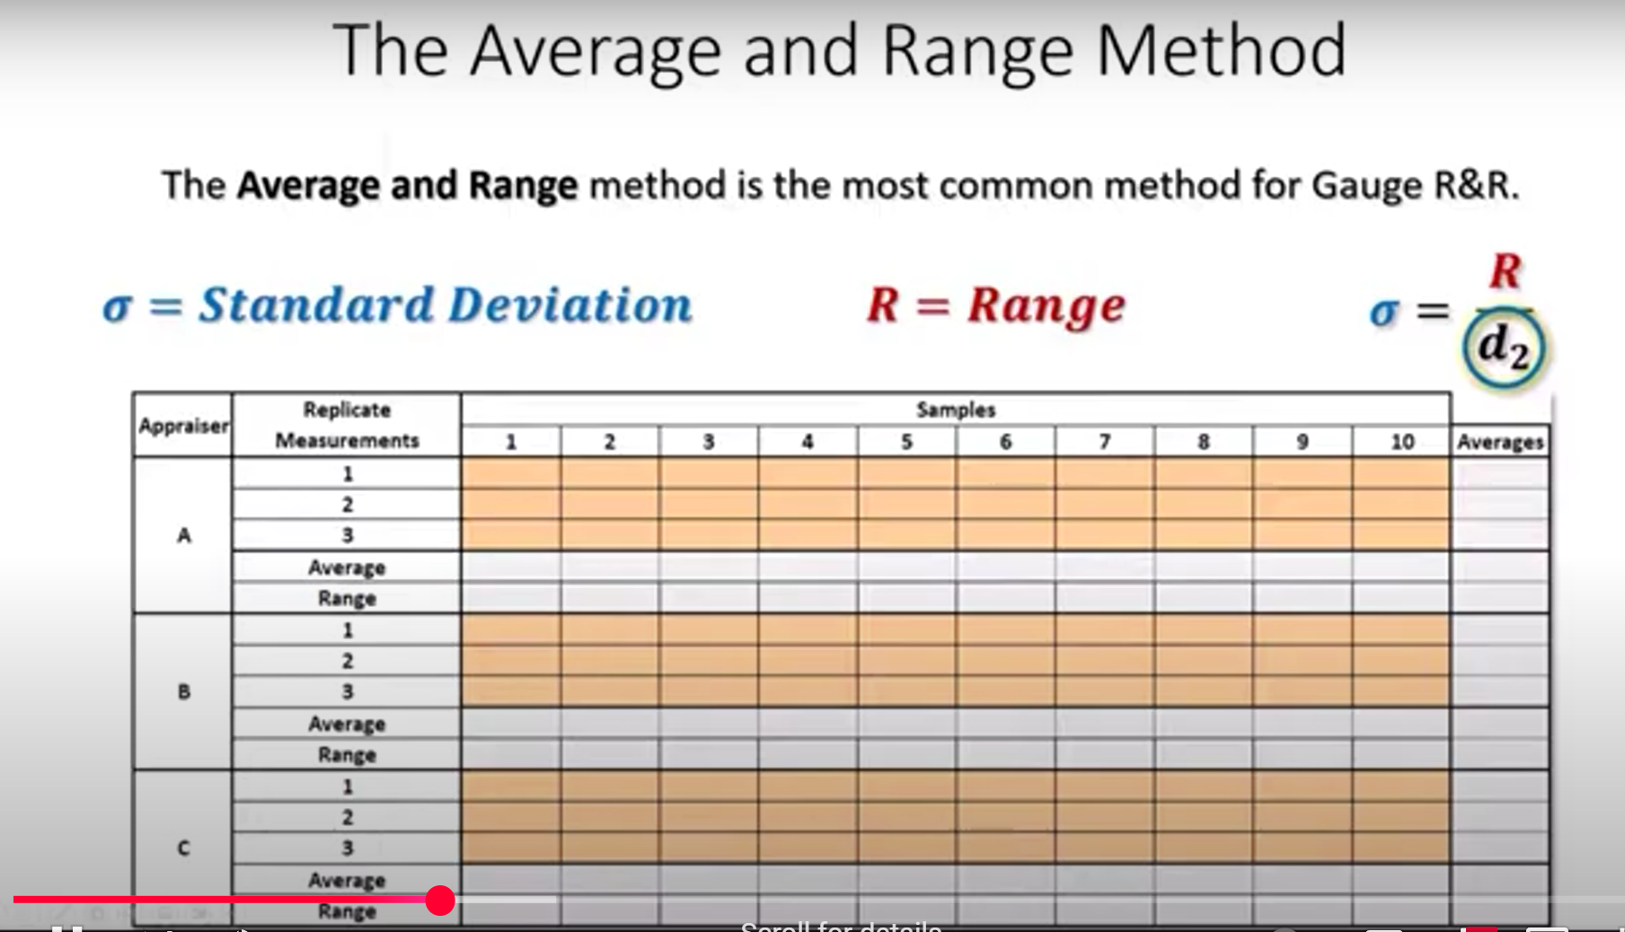
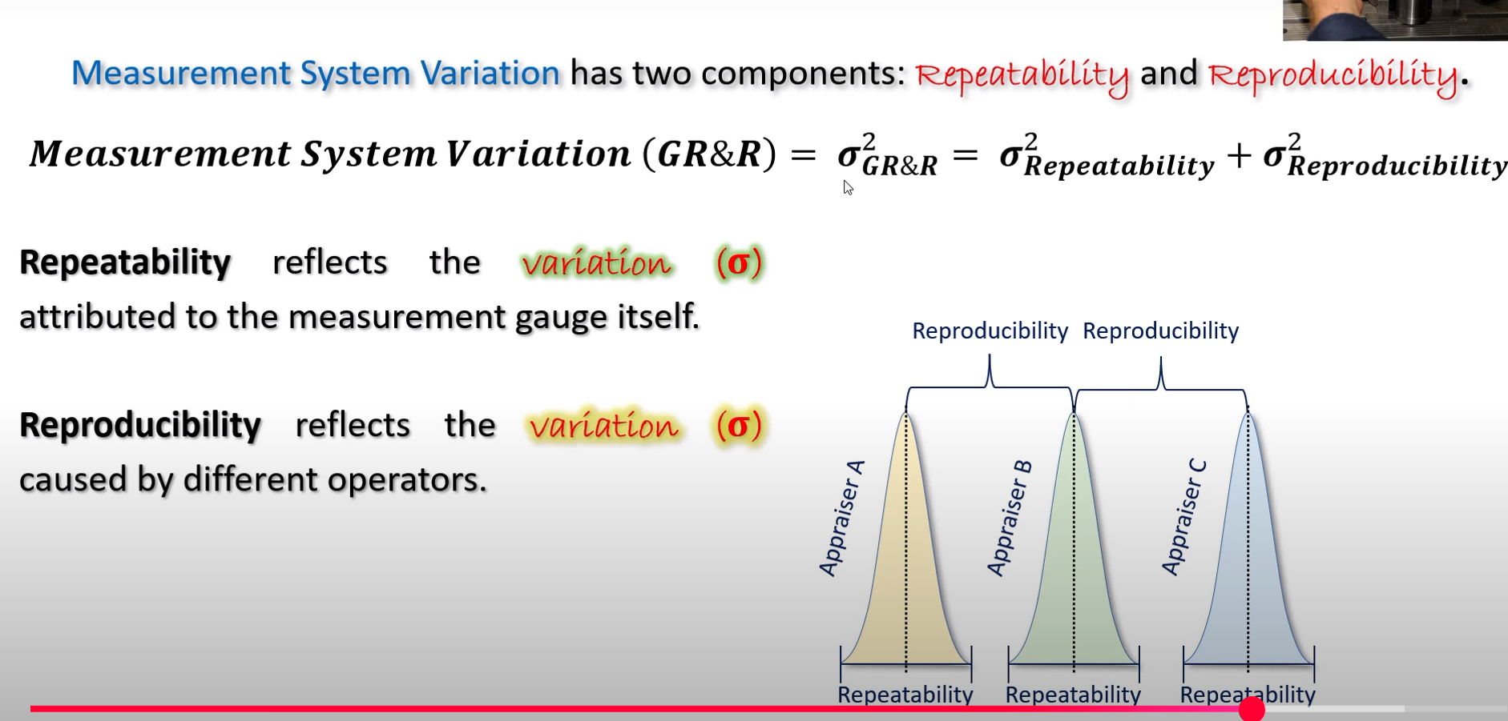
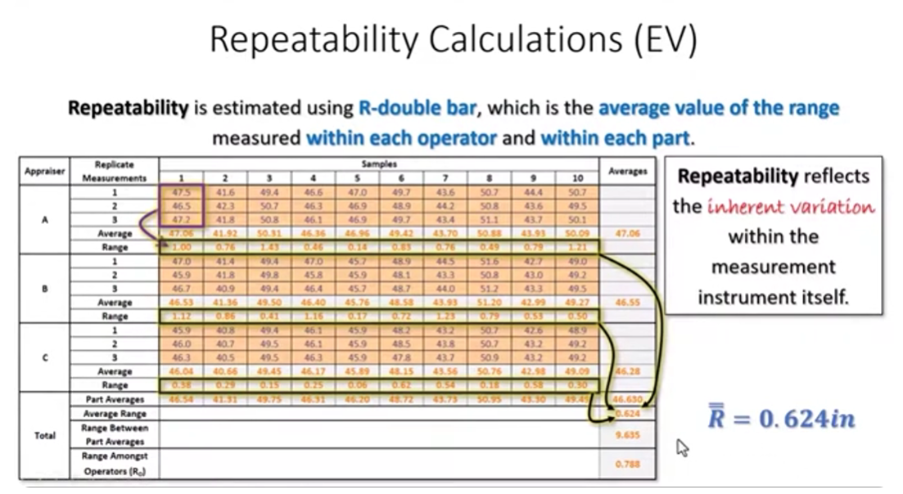
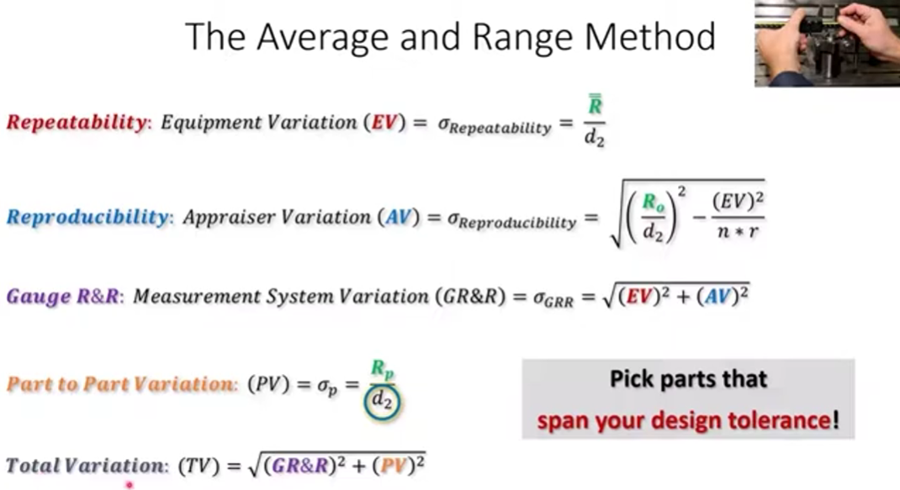

Slide 19
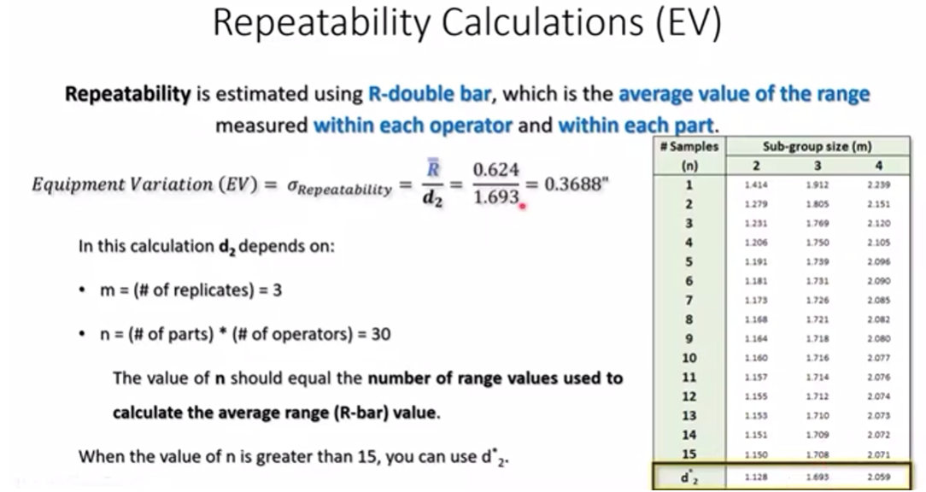
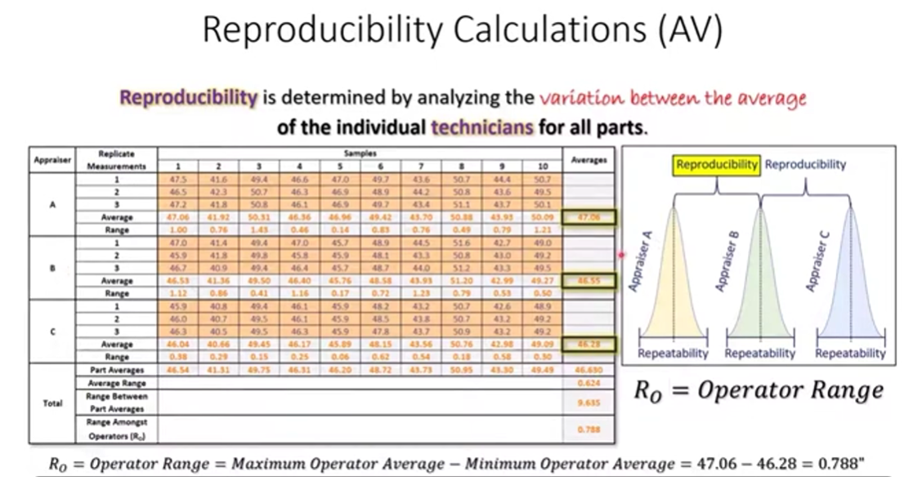
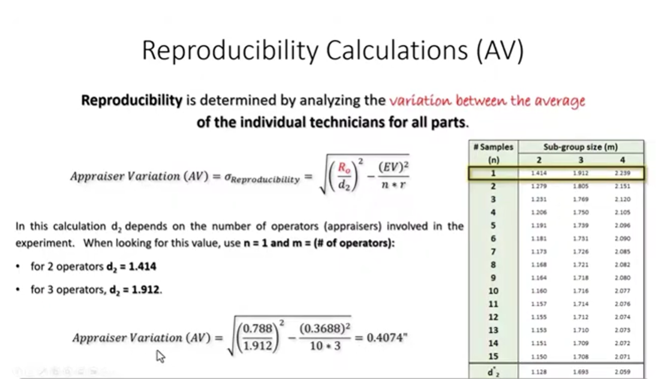
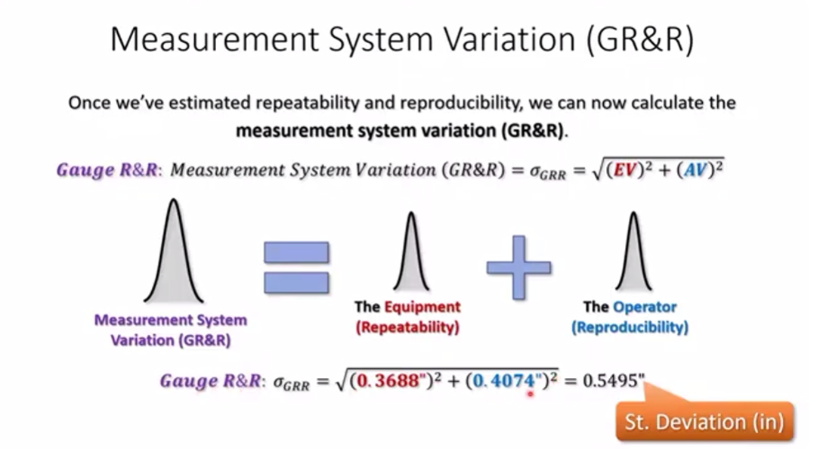

Slide 20
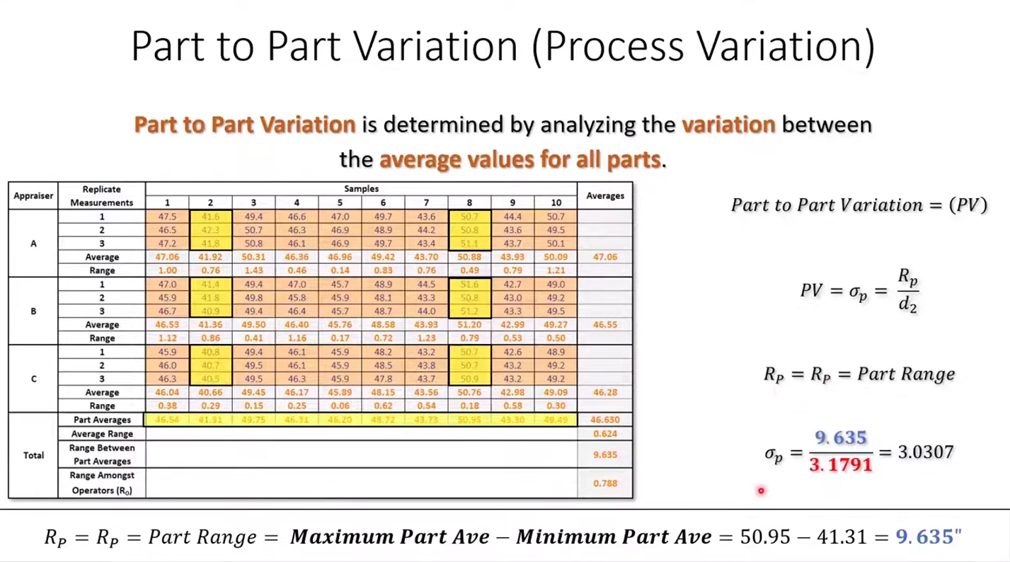
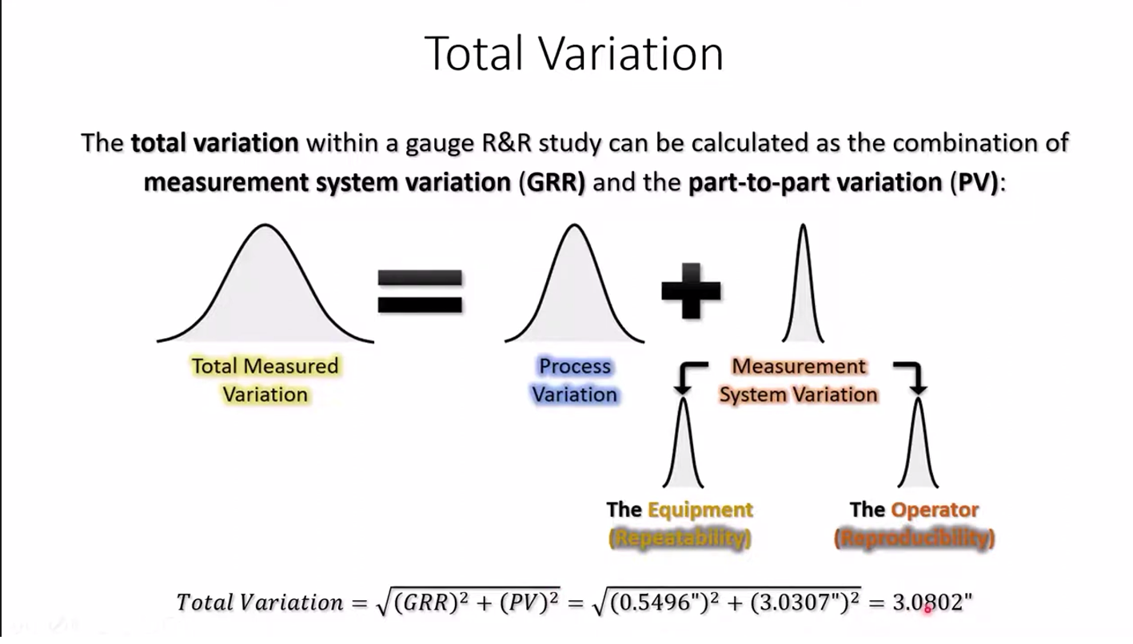

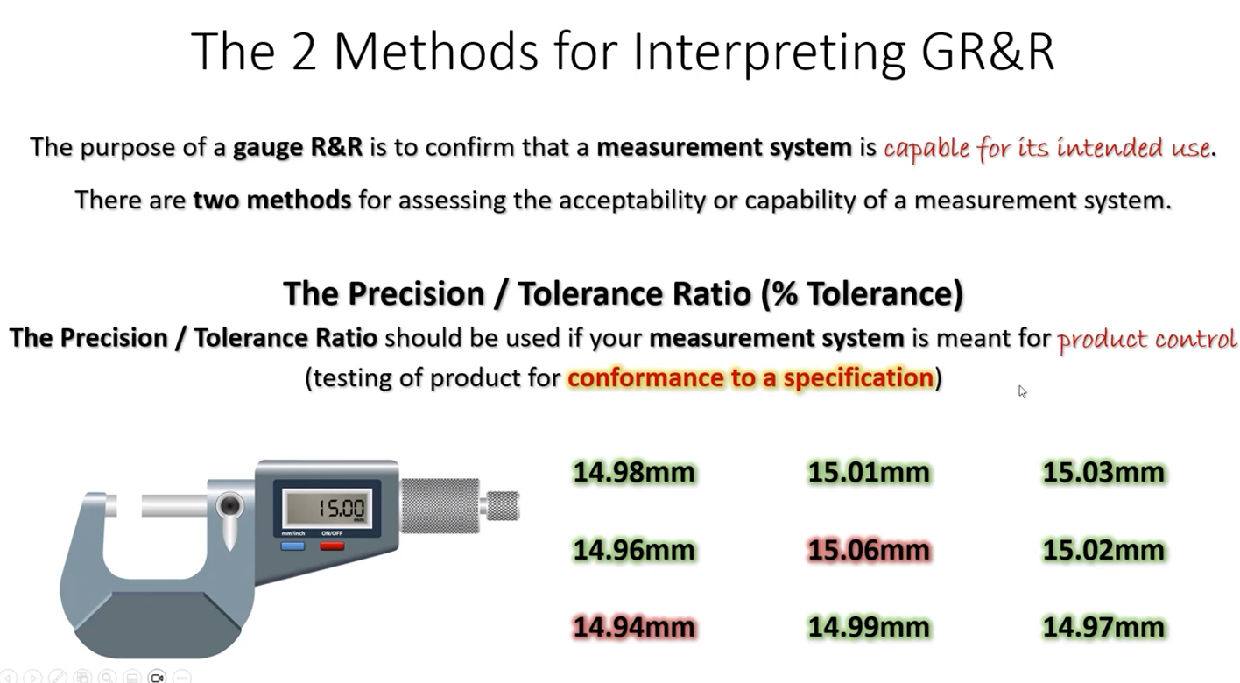
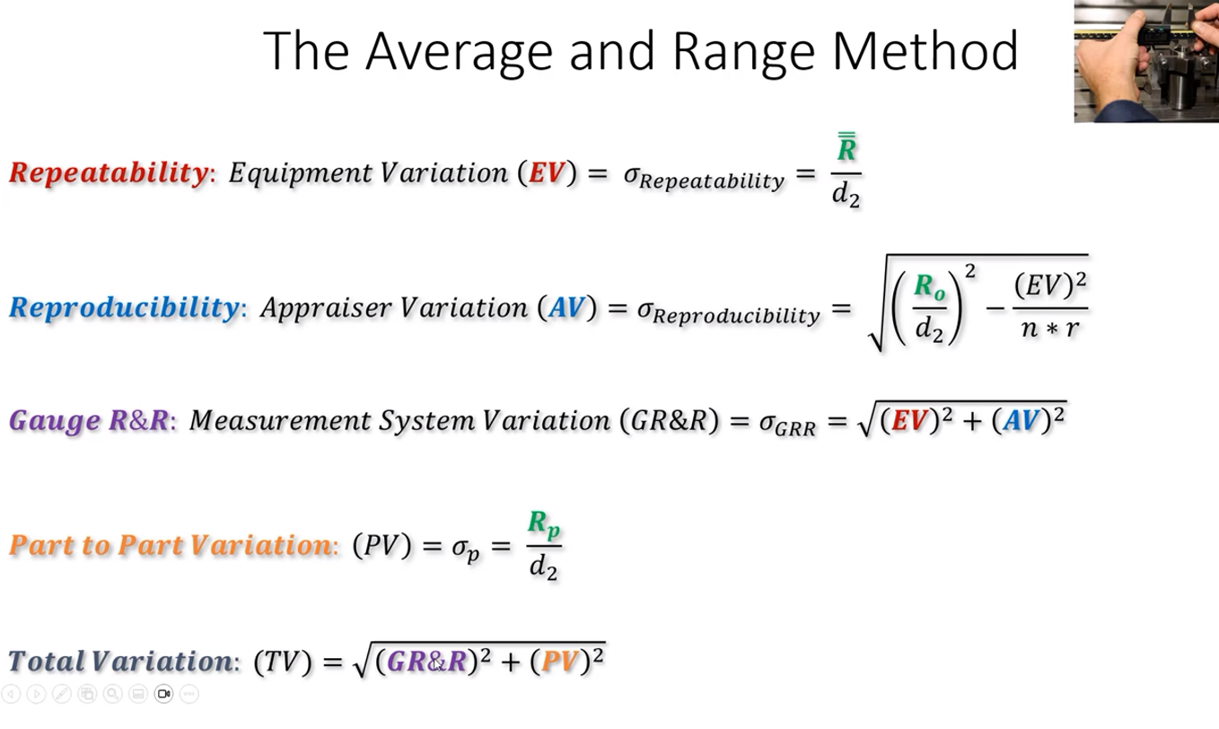

Slide 21
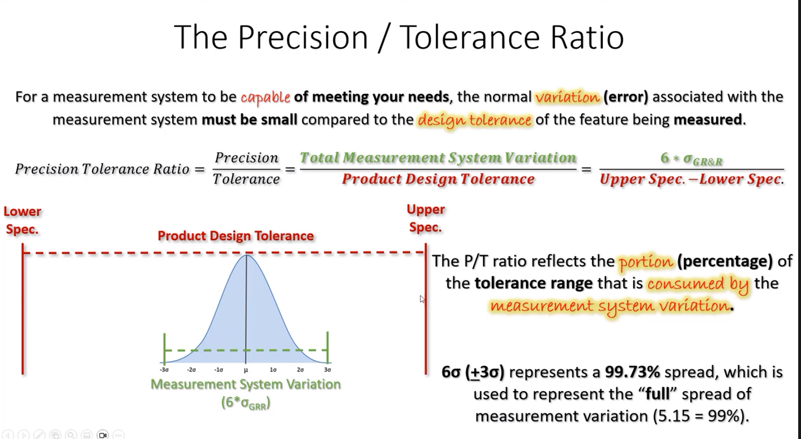
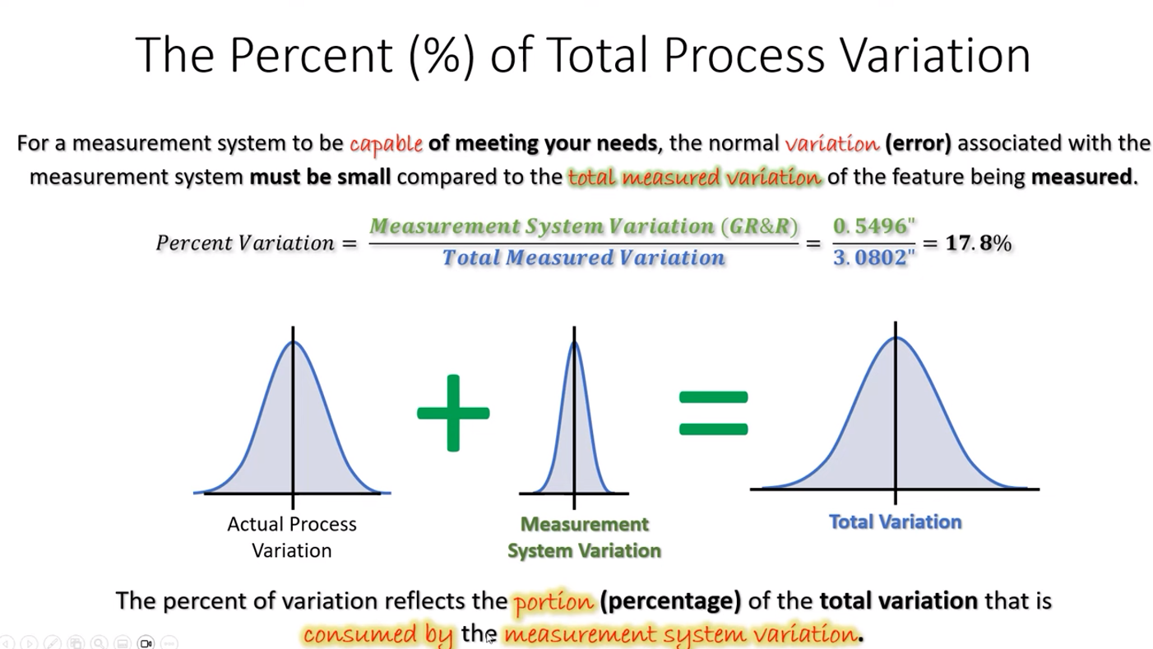

Slide 22
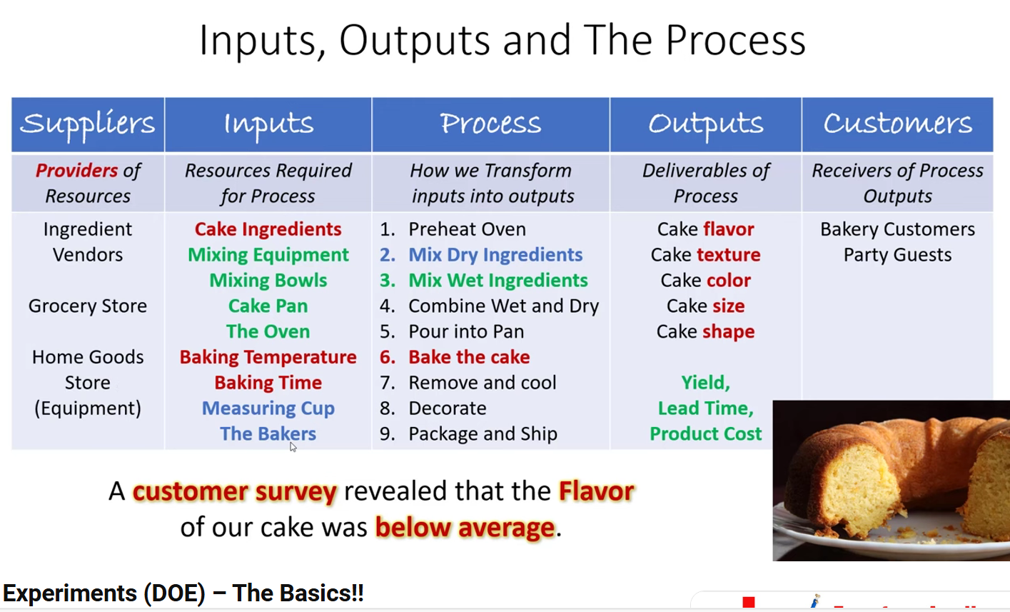
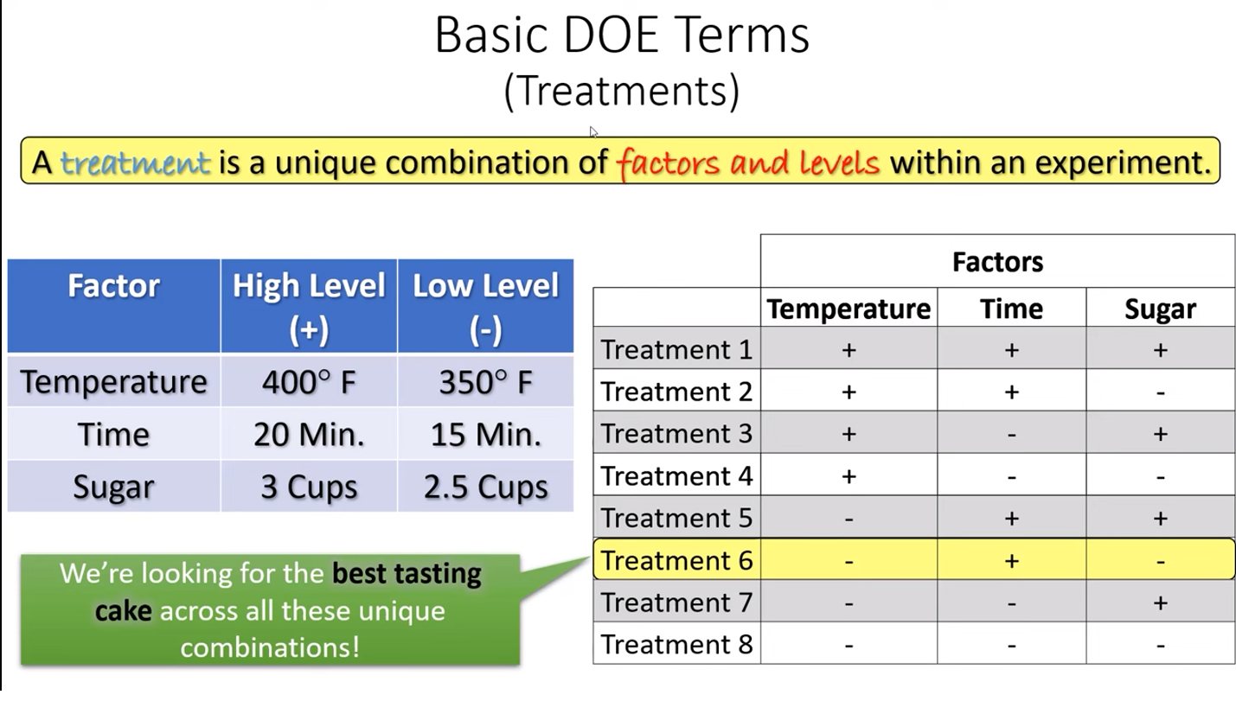
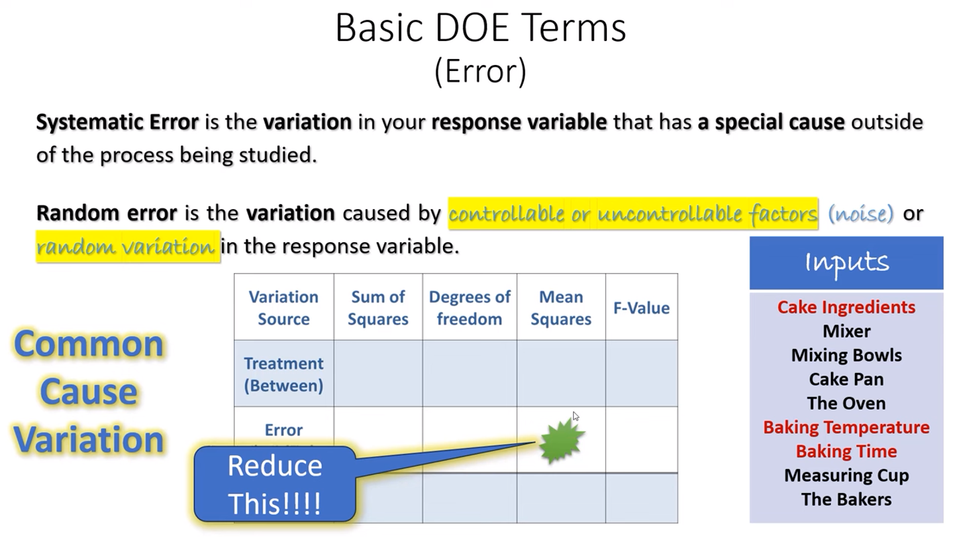
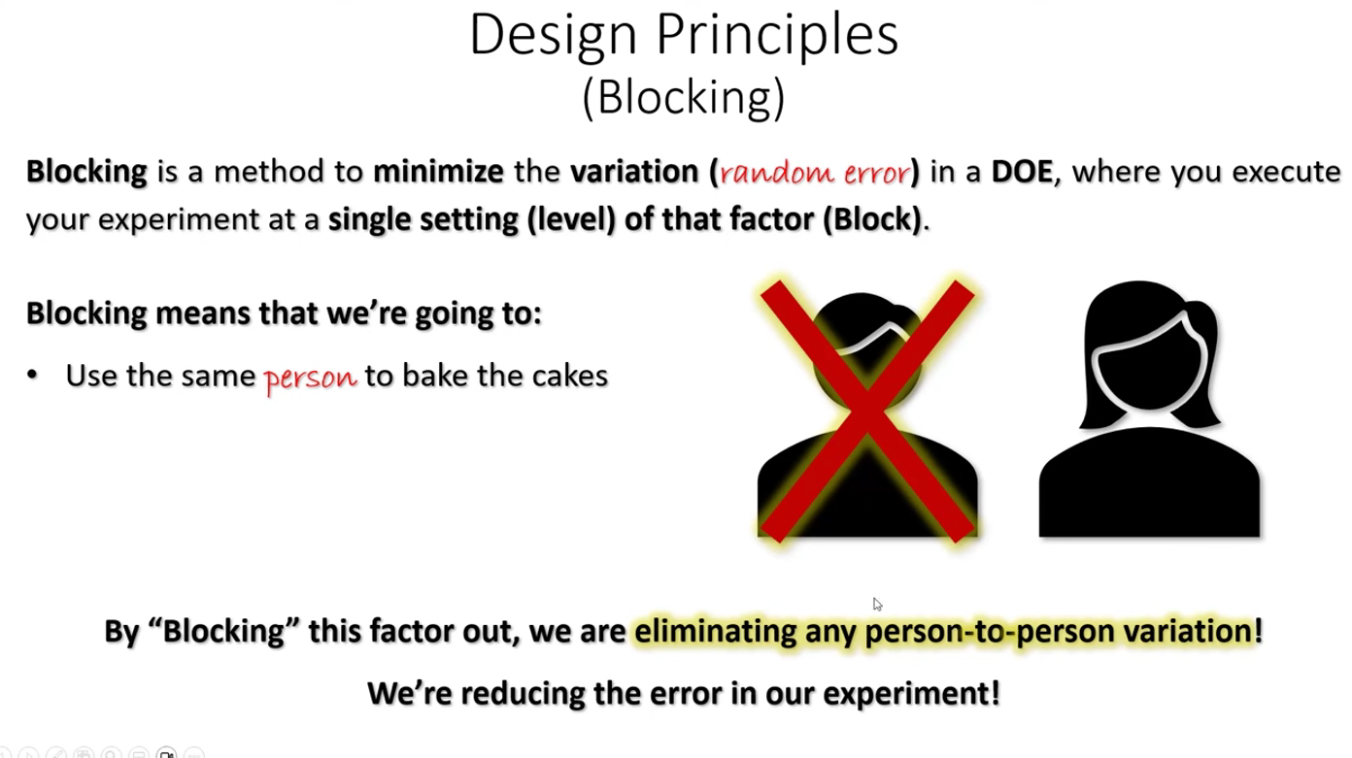
DOE SIPOC
DOE Design Matrix

Slide 23
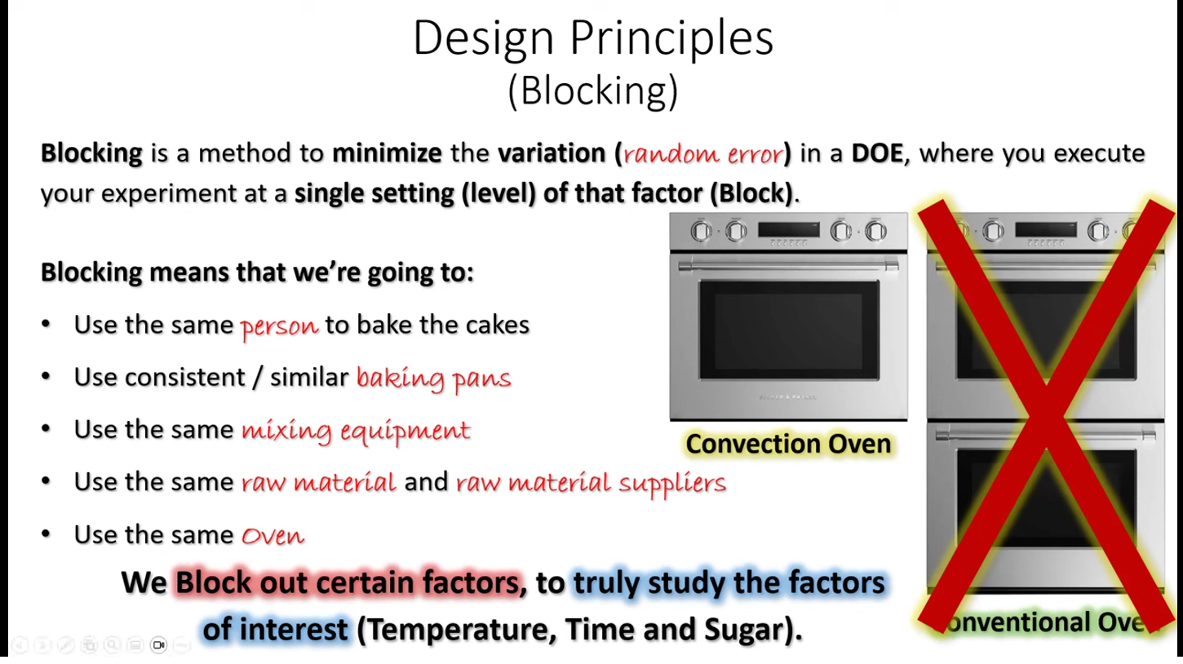
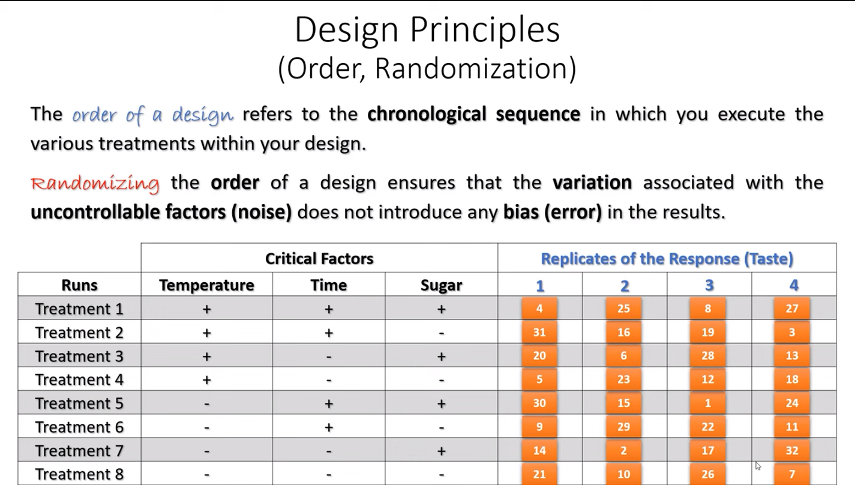

Slide 24
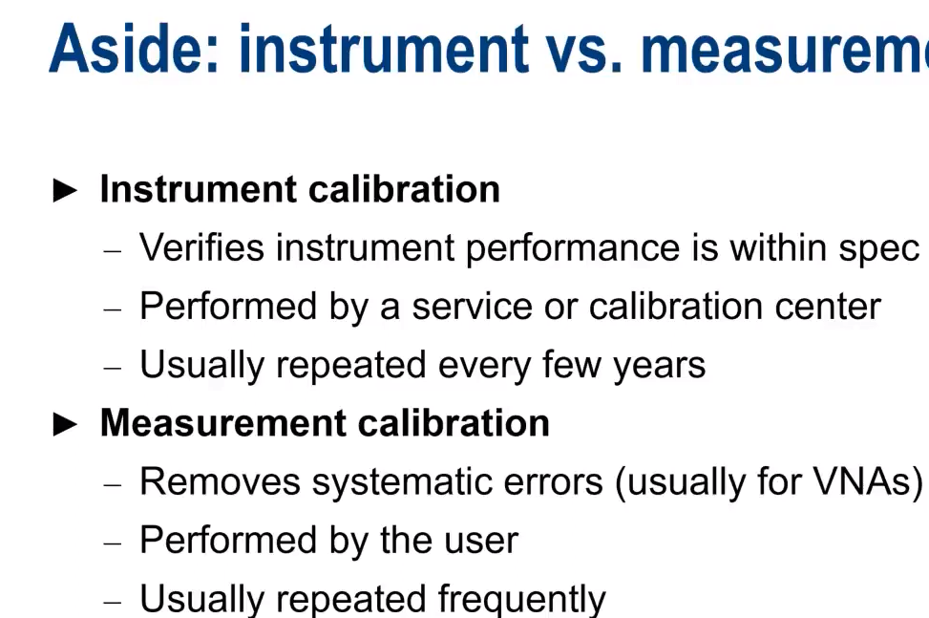
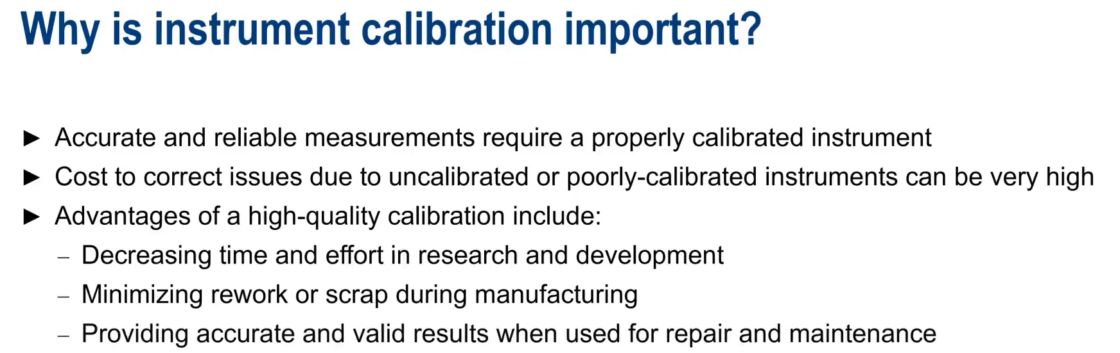



Slide 25
200Ω
Target TP Uncertainty
Target TP
(Test point)
Switch Point
100Ω
Switch Zone
Spec 1 Fill Hi
LCL
Spec 1 Fill Lo
UCL
Test Set Point
RNG_Stop
Full
Empty
LEVEL
Target TP Uncertainty
200Ω
Target TP
(Test point)
Switch
Point
100Ω
Switch Zone
Spec 1 Drain Hi
Spec 1 Drain Lo
Test Set Point
RNG_Stop
Full
Empty
LEVEL

Slide 26
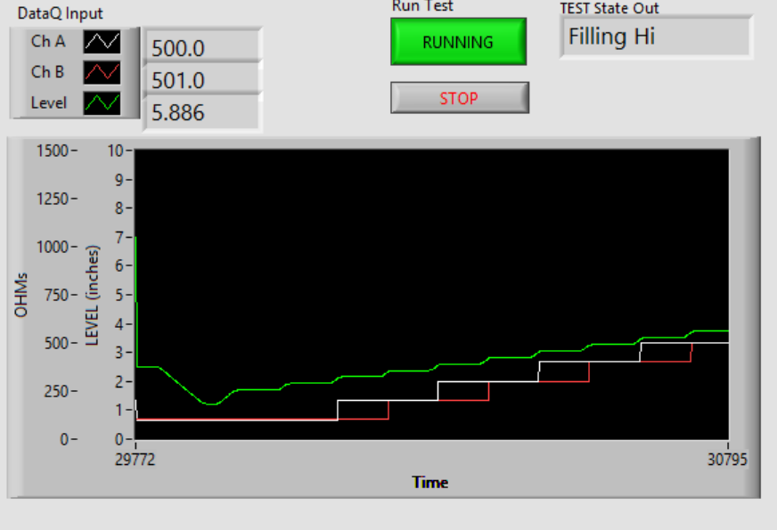
Numeric
Outputs
Test Protocol
Current State
FULL
Level Filling Shown
(opposite of ATP Spec}
Ch A & Ch B
Resistance
EMPTY

Slide 27
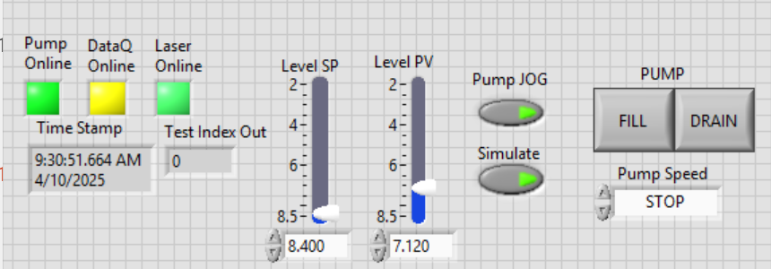
Automatic
Controls
Mode Select
Manual
Controls
Status

Slide 28
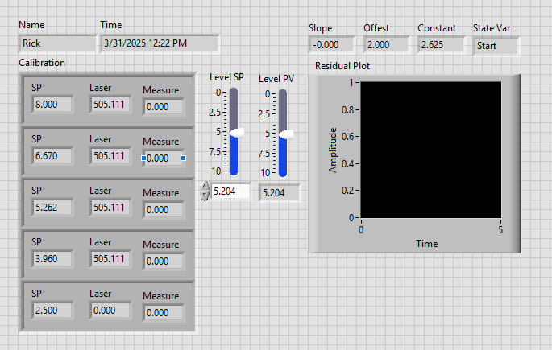
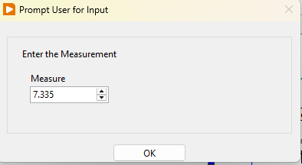
Depth Gauge Reading
Raw Laser Value (per ATP)
Depth Gauge Reading

Slide 29
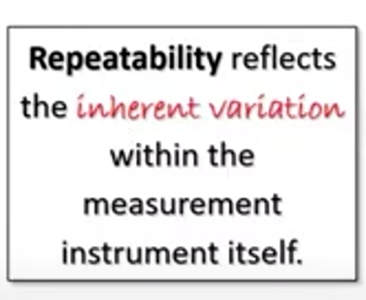
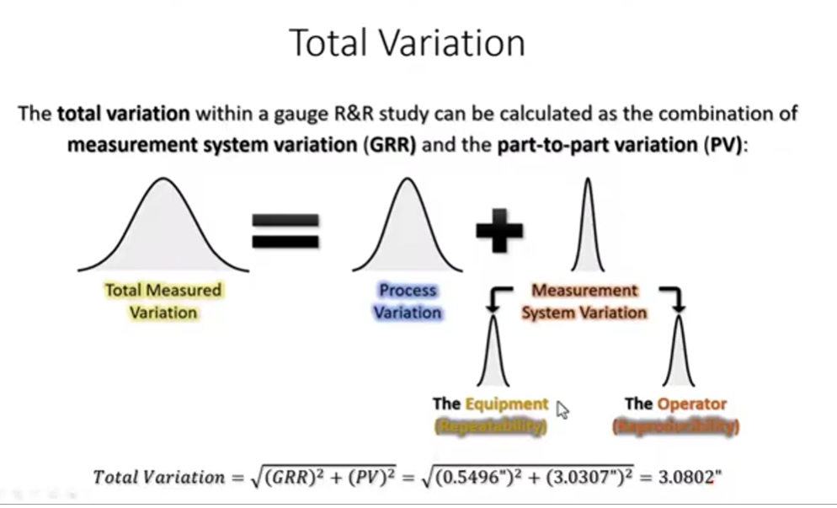
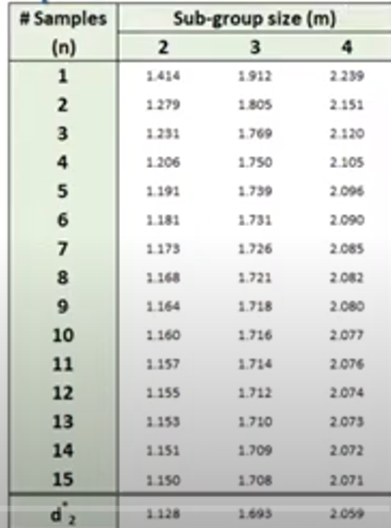

Slide 30
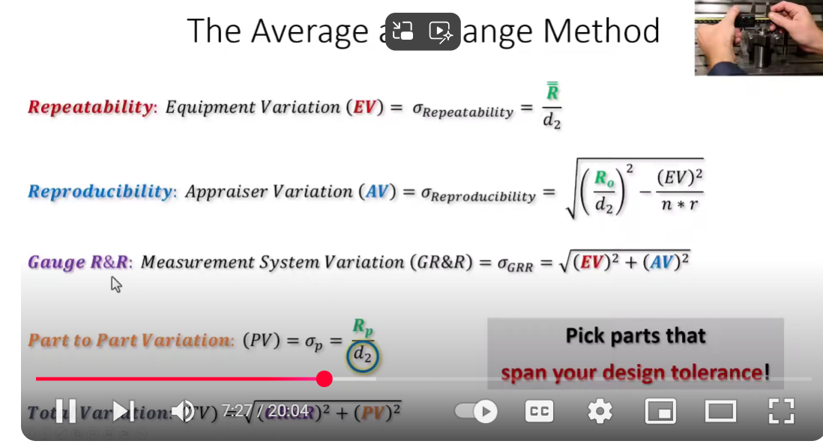

Slide 31

MLOI Gage R & R Evaluation Plan
Level Calibration
3 Appraisers
5 Replicates
Resistance Calibration
1 Appraiser
5 Replicates
Process/Part Variation
5 Sensors
B
C
+
+
A
3 Appraisers
-2σ
+2σ
Total Measured Variation
3 Level Calibrations
5 Sensors
6 Replicates
1 Resistance Calibration
TOTAL 90 Measurements
Cal 1 Cal 2 Cal 3
Gage R & R
Step 1: Have 3 different Appraisers perform Calibration.
Step 2: Use the mean and 95% Limits for the Gage R&R for AV.
Step 3: One Appraiser performs 5 calibration of the resistance.
Step 4: Use the mean resistance calibration.
Step 5: Create two randomized test plans of 3 replicates each.
Step 6: Run Test Plan 1 in the AM, Run Test Plan 2 in the PM.
=

Slide 32
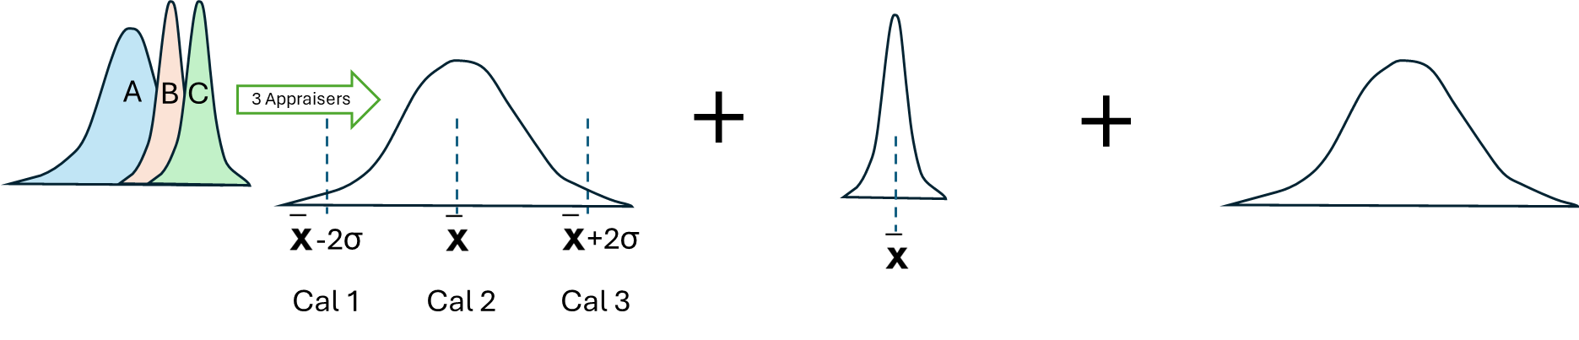
MLOI Gage R & R Evaluation Plan
Level Calibration
3 Appraisers
5 Replicates
Resistance Calibration
1 Appraiser
5 Replicates
Process/Part Variation
5 Sensors
Total Measured Variation
3 Level Calibrations
5 Sensors
6 Replicates
1 Resistance Calibration
TOTAL 90 Measurements
=
Gage R & R
Step 1: Have 3 different Appraisers perform Calibration.
Step 2: Use the mean and 95% Limits for the Gage R&R for AV.
Step 3: One Appraiser performs 5 calibration of the resistance.
Step 4: Use the mean resistance calibration.
Step 5: Create two randomized test plans of 3 replicates each.
Step 6: Run Test Plan 1 in the AM, Run Test Plan 2 in the PM.
EV = Sample_Range_Avg/d2(1.692)
AV = √ Cal_Range_Avg/ d2(1.912) –(EV)²/(n*r)
V_{GRR} = √EV² + AV²
PV = Part_Range_Avg//d2(3.1791)
Goodness % = V_{GRR/}PV < 10%

Slide 33


Slide 34


Voltage readings are highlighted yellow
Ohm readings are highlighted green

Slide 35

Resistor
Calibration

Slide 36


ChA PLUS
ChB PLUS
ChA PLUS
ChB PLUS
ChA GND
R100-A
R1K-A
ChB PLUS
ChB
GND
ChA PLUS
GND
All these bus wires are GND
R100-B
R1K-B

Slide 37

Speed OutputA Output B
Neg Signal GND
Pos GND Signal

